Slide 1

Advanced Data Analytics
Accredited by

Slide 2

Data Analytics
Process of exploring and analyzing data to gain insights and drive informed decision-making within organizations.
Encompasses a wide range of techniques, methodologies, and tools aimed at leveraging data to improve business performance, enhance operational efficiency, and achieve strategic objectives.

Slide 3
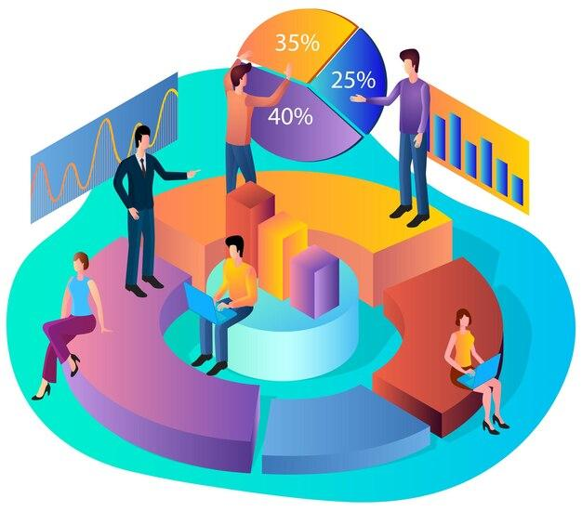
Different Stages in Data Analytics
Collecting the data
Collection of relevant data from various sources, including internal databases, external sources, and third-party data providers.
Cleaning and preparing the data
Clean, integrate, and transform the data into a format suitable for analysis.
Exploring and summarizing data
Visually explore and summarize data to identify patterns, trends, and relationships.
Applying methods and models
Apply statistical methods and models to quantify relationships between variables, test hypotheses, and make predictions.
Forecasting/predicting future outcomes
Forecast future outcomes or trends based on historical data and statistical algorithms

Slide 4


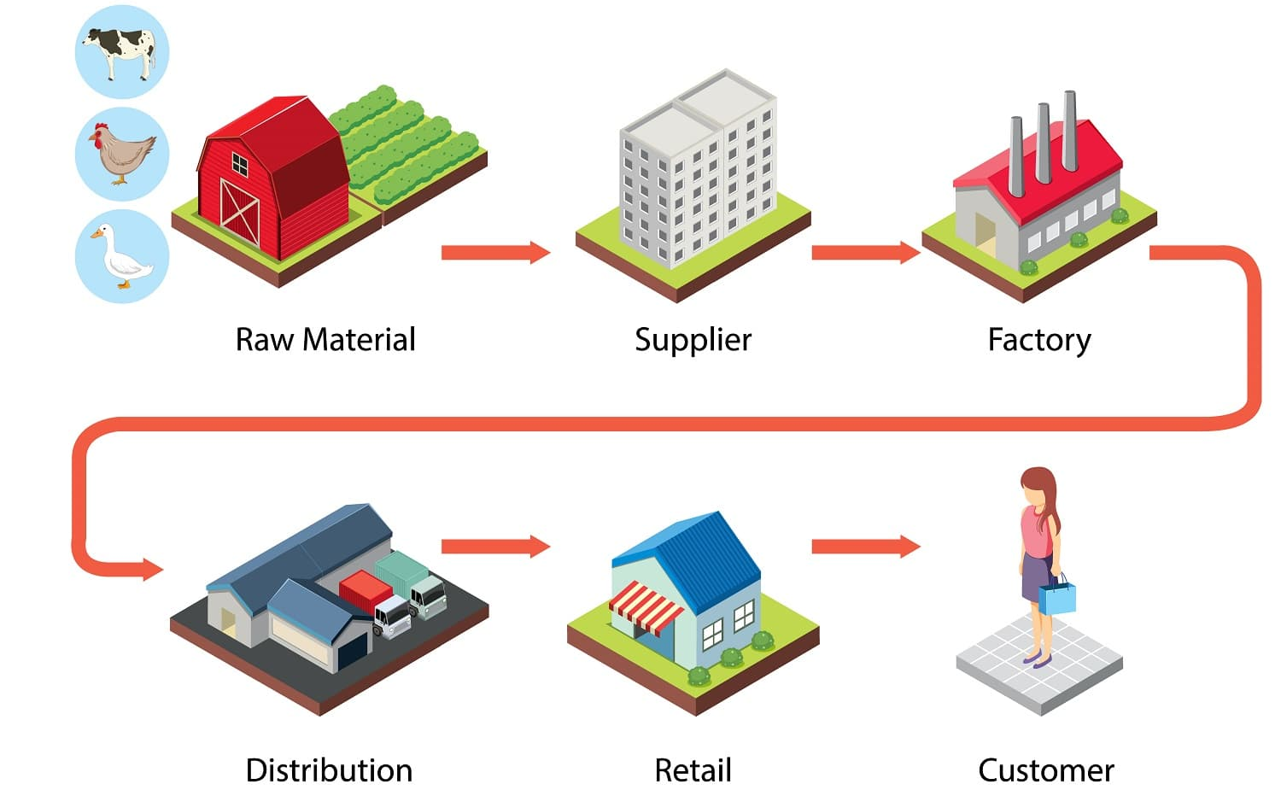
Application of Business Analytics
Customer Segmentation
Sales Forecasting
Supply chain optimization
Risk Analysis
Operational Efficiency
Predictive Maintenance

Slide 5
Data Sources
Internal Data. Eg. Customer Data, Sales data.
External Data. Eg. Social Media Platform, Market research firms, and Government agencies.
Public Data. Eg. Census data, Weather data.
Third-party Data: This refers to data that is purchased or acquired from third-party sources, such as data brokers or data providers.
The choice of data sources will depend on the specific objectives of the analysis and the type of insights that are needed.

Slide 6



Data Sources
Database
Spreadsheets
Big Data Platforms
APIs

Slide 7
Challenges
Poor data quality, including inaccuracies, inconsistencies, and incompleteness.
So we need accurate data to get accurate results
Integrating data from disparate sources with different formats and structures presents additional challenges.
So we need a structured format to smooth analysis
Protecting sensitive data from unauthorized access, breaches, and compliance violations.
So the data should be protected
Challenges in recruiting and retaining qualified talent with diverse skills like programming, data analysis, statistical modelling, and domain expertise.
So skill gap is there, proper knowledge is required
Rapidly evolving landscape of analytics tools and technologies can be overwhelming for organizations to navigate and implement effectively.
So continuous learning mindset is needed.

Slide 8
Building and Optimizing Models

Slide 9
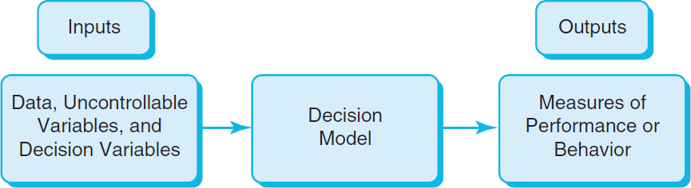
Decision Modeling
A logical or mathematical representation of a problem or business situation that can be used to understand, analyze, or facilitate making a decision.
Inputs:
Uncontrollable variables, which are quantities that can change but cannot be directly controlled by the decision maker.
Decision variables, which are controllable and can be selected at the discretion of the decision maker.

Slide 10
Example: Inventory Planning
Scenario: A shop owner is planning stock for next week.
Question: How many units should be stocked?
Goal
Meet customer demand
Avoid extra stock (waste, storage cost)
Stock enough, but not too much

Slide 11
Step 1: Estimate Demand
Use past data:
Last week sales = 90 units
Average weekly sales = 100 units
So, expected demand ≈ 100 units
Step 2: Understand Costs
If extra stock remains:
Storage cost
Risk of damage/spoilage
This is called: Holding Cost

Slide 12
Step 3: Test Different Decisions (Scenarios)
Scenario A: Stock = 200 units
Demand = 100 units
Result:
100 units unsold
Storage cost increases
Waste/spoilage possible
Profit decreases
Scenario B: Stock = 60 units
Demand = 100 units
Result:
Not enough products
Customers unhappy
Lost sales
Profit decreases
Final Decision (Optimal Point)
We need a balance point
Best Stock: 100 – 110 units

Slide 13
Prescriptive Model Pricing
Predictive Analytics with Regression Techniques

Slide 14
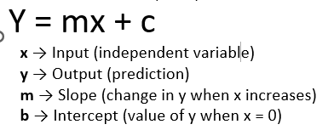
Prescriptive Model Pricing
A firm wishes to determine the best pricing for one of its products in order to maximize profit.
Analysts determined the following model: Sales = -2.9(price) + 3000
Total revenue = (price)(sales)
Fixed cost = 5000
Total Cost = 10(Sales) + 5000
Identify the price that maximizes profit, subject to any constraints that might exist.
Price | $ 100
Sales | 2950
Total Cost | $ 34,500
Cost per unit | $ 12
Profit | $ 260,500
Sales = -2.9 (Price) + 3000
Total revenue = (Price)(Sales)
Cost = 10(Sales) + 5000

Slide 15
Sales Promotion Decision
Predictive Analytics with Regression Techniques

Slide 16


Sales Promotion Decision
In the grocery industry, managers typically need to know how best to use pricing, coupons and advertising strategies to influence sales.
Controlled experiments:
Grocers implement different combinations of pricing, coupons, and advertising to observe the resulting sales. Analytics helps develop a predictive model of sales as a function of these decision strategies.

Slide 17
Sales Prediction with Multiple Regression Analysis
Sales Promotion Data
Week | Price | Ads Budget (Thousands USD ) | Sales
1 | $15.0 | 1500 | 1240
2 | $16.4 | 4000 | 950
3 | $13.0 | 2000 | 1580
4 | $16.5 | 3000 | 1190
5 | $12.0 | 1000 | 1430
6 | $11.0 | 1000 | 1560
7 | $14.3 | 1000 | 1060
8 | $18.2 | 3465 | 800
9 | $9.6 | 1000 | 1895
10 | $15.4 | 4000 | 1475
11 | $12.0 | 2000 | 1560
12 | $14.0 | 1000 | 1235
13 | $16.0 | 3000 | 1065
14 | $15.0 | 1000 | 1025
15 | $11.0 | 2000 | 1645
Find the pricing and Ads Budget to maximize the Sales
Use Multiple Linear Regression
Cost price of the Product is $8
Minimum Profit desired is $10,000
Cost Price per unit $9.00
Minimum Profit $4,000.00
Maximum Ads Budget $10,000.00
Minimum Ads Budget $1,000.00
 | Coefficients
Intercept | 3092.883488
Price | -142.5484493
Ads Budget | 0.10225716
Results from
Regression Analysis
Solution: Sales = -142 x Price + 0.10 x Ad+3091

Slide 18
Predictive Analytics with less uncertainty
Stable, well understood systems with established patterns can utilise low-uncertainty predictions effectively.

Slide 19
What is Uncertainty?
Uncertainty means: Lack of clarity , Difficult to predict , System is complex
Key Idea
Predictive analytics works better when: The system is stable and predictable
Important Points
Stable systems give accurate results
Prediction accuracy depends on how stable and predictable the system is
Some systems behave in a regular and consistent way
Other systems may change suddenly and unpredictably
Example
A grocery store that sells similar quantities every week
Sales are consistent
Patterns repeat
Predictive Analytics with Less Uncertainty Means
Systems behave consistently
Patterns repeat over time
Relationships between variables are well understood

Slide 20
KERC Inc – Car Manufacturer Optimization Model -1
Predictive Analytics with Less uncertainty

Slide 21
KERC Inc – Car Manufacturer
Has two main car models
KERC 501
KERC 601
Below table provides the Activity times (hrs) of the models
 | Activity time in Hours
Car Model | Assembly ( All parts) | Frame Fitting and Painting | Quality Assurance
KERC 501 | 8 | 4 | 2
KERC 601 | 10 | 3 | 1.6

Slide 22
KERC Inc – Car Manufacturer…
KERC Manufacturing Unit has a limited resources for activities as below
Manufacturing Activity | Time Available Hours per Week
Assembly ( All parts) | 10800
Frame Fitting and Painting | 4500
Quality Assurance | 2500
Car Model Profitability Table
Car Model | Profit (USD Thousands)
KERK 501 | 4.9
KERK 601 | 5.8

Slide 23
Optimize KERC production
Define Objective Function (profit) and find the Optimal manufacturing quantities for car models to maximize the objective function?
Goal: How many of each model should be produced without exceeding the available hours.

Slide 24
WonderZon Retailer Optimization Model of Logistics to minimize cost
Predictive Analytics with Less uncertainty

Slide 25
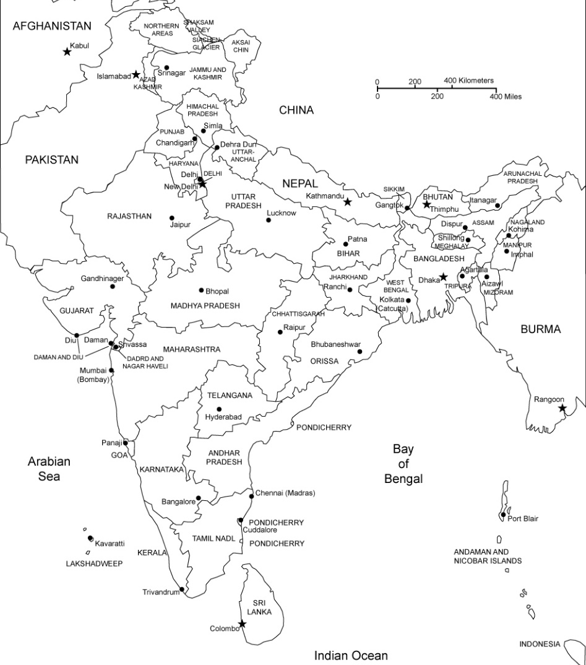
Find Objective function for cost and optimize the network for min logistics cost for WonderZon Retailer
Warehouses | Shipment Quantity
Gurgaon | 25
Mumbai | 50
G(25)
Delivery Centers | Minimum Quantity
Bengaluru (B) | 20
Hyderabad(H) | 25
Chennai(C) | 15
Logistics Cost in INR per Package |  | Delivery Centers
 | From / To | Bengaluru (B) | Hyderabad (H) | Chennai (C)
Warehouses | Gurgaon (G) | 116 | 106 | 115
 | Mumbai (M) | 110 | 95 | 112
M(50)
H(>25)
B(>20)
C(>15)

Slide 26
Predictive Analytics with High Uncertainty

Slide 27
Internet Usage - Plan Decision Monte Carlo Simulation
Predictive Analytics with high uncertainty

Slide 28
SMART IT Inc. Internet Plan
SMART IT Inc has been using FLEXI corporate internet plan for a year and thinking about deciding to switch to FAST1000. SMART IT Inc business is seasonal and internet usage varies as per the demand. Generally bill usage vary from around 1000 GB. Past 6 months usage in GB are 620,1050,1200,1480,870,1600
Find the best plan for SMART IT ( Use Monte Carlo Simulation with Normally distribution data)
Corporate Internet Plans
FLEXI | Flat plan charging $2 per GB
FAST1000 | 1000 GB included , Post 1000 GB , $1500 + $3.5 per GB

Slide 29
Monte Carlo Simulation
It is a probability model used to predict the probability of various outcomes.
It is used to mitigate the possibility of unpredicted outcomes.

Slide 30
Kickathlon Sport Retailer Decision Tree & Monte Carlo Simulation
Predictive Analytics with High uncertainty

Slide 31
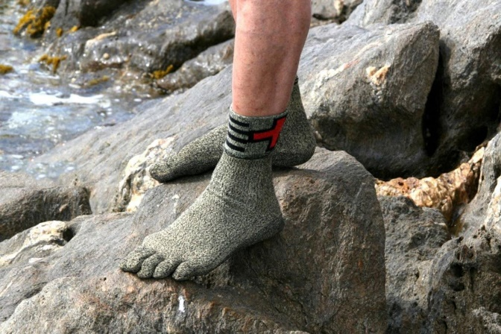
Kickathlon – Supplier Decision Making
Kickathlon, A French based Sports Retailer, plans to introduce a new product, TrekBareFoot – A tough Polyester based Socks, which can protect the foot while trekking barefoot.
TrekBareFoot is scheduled to launch in next Summer beginning so should be manufactured well in advance.
The price tag for TrekBareFoot is fixed at $200/-
If the marketing efforts create a strong demand then about 15000 units can be sold, on the lower side, weak demand might end up with only 6000 units.
There is a 50:50% chance for strong and weak demand in the market.
TrekBareFoot being a specialized product, Kickathlon found only two suppliers one in USA and other in China. The pricing is as below.
 | USA (A) | China (C)
Supplier Capacity | 6000 | 15000
Fixed Contract Charges | 0 | $500,000
Unit Product cost | $150 | $130
Profit per unit | $50 | $70

Slide 32
Decision Trees
A Decision Tree is a visual and analytical decision support tool that helps map out decisions and their possible consequences, including risks, costs and benefits.

Slide 33
Decision Tree – Key Components
Decision Nodes
There are decision points where it branches to more than one decisions
Chance / Event Nodes
There are points of uncertainty, which is defined by probability / random variable
Outcome Nodes
There are the outcome variable ( Objective function), which needs to be either maximized or minimized.

Slide 34
Kickathlon – Supplier Decision Tree
$ 0
Contract No one
15000 units
+ $300,000
Strong
0.5
Gross Profit = 6000*$50 =$300,000
As supplier A can only supply 6000
Contract USA(A)
- $ 0
Supplier?
Weak
0.5
6000 units
Market
Demand
+ $300,000
- $ 0
Gross Profit = 6000*$50 =$300,000
Contract China(C)
15000 units
+ $550,000
Strong
0.5
Gross Profit = 15000*$70 - $500000 =$550,000
As supplier B can all 15000
- $ 500,000
Market
Demand
Weak
0.5
6000 units
- $80,000
- $ 500,000
Gross Profit = 6000*$70-$500,000 =-$80,000

Slide 35
Common Decision Strategies
Maxi – Mini Strategy : Risk Averse Strategy
Maximize the Minimum outcome
Avoids bad outcomes and ignores possibility of good outcomes with risk.
Maxi – Maxi Strategy : Risk Seeking Strategy
Maximize the Maximum outcome
Seeks good outcomes and ignore possibility of bad outcomes
Maximize Expected Value : Risk Neutral Strategy
Equal consideration of Good and Bad outcomes

Slide 36
Maxi-Min Strategy
$ 0
Contract No one
15000 units
+ $300,000
Strong
0.5
Gross Profit = 6000*$50 =$300,000
As supplier A can only supply 6000
- $ 0
Contract USA(A)
+ $300,000
Contract will be awarded to Supplier A
from USA
Supplier?
Gross Profit = 6000*$50 =$300,000
As supplier A can only supply 6000
Weak
0.5
6000 units
Market
Demand
+ $300,000
- $ 0
Gross Profit = 6000*$50 =$300,000
Contract China(C)
15000 units
+ $550,000
Strong
0.5
Gross Profit = 15000*$70 - $500000 =$550,000
As supplier B can all 15000
- $ 500,000
- $80,000
Market
Demand
Weak
0.5
6000 units
Gross Profit = 6000*$70-$500,000 =$180,000
- $80,000
- $ 500,000
Gross Profit = 6000*$70-$500,000 =$180,000

Slide 37
Maxi-Maxi Strategy
$ 0
Contract No one
15000 units
+ $300,000
Strong
0.5
Gross Profit = 6000*$50 =$300,000
As supplier A can only supply 6000
- $ 0
Contract USA(A)
+ $300,000
Supplier?
Gross Profit = 6000*$50 =$300,000
As supplier A can only supply 6000
Weak
0.5
6000 units
Market
Demand
+ $300,000
- $ 0
Gross Profit = 6000*$50 =$300,000
Contract China(C)
15000 units
+ $550,000
Strong
0.5
Gross Profit = 15000*$70 - $500000 =$550,000
As supplier B can all 15000
+ $550,000
Contract will be awarded to Supplier B
from China
- $ 500,000
Gross Profit = 15000*$70 - $500000 =$550,000
As supplier B can all 15000
Market
Demand
Weak
0.5
6000 units
- $80,000
- $ 500,000
Gross Profit = 6000*$70-$500,000 =$180,000

Slide 38
Maximize Expected Value Strategy
$ 0
Contract No one
15000 units
+ $300,000
0.5 x 300,000 + 0.5 x 300,000 =
$300,000
Gross Profit = 6000*$50 =$300,000
As supplier A can only supply 6000
Strong
0.5
Contract USA(A)
- $ 0
Contract will be awarded to Supplier A
from USA
Supplier?
Weak
0.5
6000 units
Market
Demand
+ $300,000
- $ 0
Gross Profit = 6000*$50 =$300,000
Contract China(C)
15000 units
+ $550,000
Strong
0.5
0.5 x 550,000 + 0.5 x (-80,000) =
275,000 – 40,000 =
$235,000
Gross Profit = 15000*$70 - $500000 =$550,000
As supplier B can all 15000
- $ 500,000
Market
Demand
Weak
0.5
6000 units
- $80,000
- $ 500,000
Gross Profit = 6000*$70-$500,000 =$180,000

Slide 39
What if the Demand when market in weak is not single value like 6000 units but a range like between 3000 to 8000 units? This is the usual scenario in practice.

Slide 40
12,000 units
$ 0
.
.
.
Contract No one
Strong
0.5
17,000 units
Supplier?
Contract USA(A)
Market
Demand
3,000 units
Weak
0.5
.
.
.
8,000 units
As supplier A can only supply 6000 units and unit profit is $50
Profit = $50 * min { 6000, Demand}
It is difficult to model with decision tree branching; we use Monte Carlo simulation for this kind of decision process

Slide 41
12,000 units
.
.
.
$300,000
As Supplier A can only deliver 6000
$ 0
Contract No one
17,000 units
Strong 0.5
Expected Value
0.5*300,000 + 0.5x257,873=
$278,936
-$ 0
Supplier?
Contract USA(A)
3,000 units
Weak 0.5
$257,873
from simulation
Contract will be awarded to Supplier A
from USA
Market
Demand
.
.
.
-$ 0
8,000 units
12,000 units
Strong 0.5
.
.
.
$520,307
from simulation
-$ -500,000
17,000 units
Expected Value
0.5*520307 + 0.5x(-109693) =
$205,306
Market
Demand
Weak 0.5
3,000 units
-$109,693
from simulation
-$ -500,000
.
.
.
8,000 units

Slide 42
What-If Analysis
What-If Analysis is a decision-making tool that helps you understand the
impact of changing input values on the outcome of a model or formula.
In simple terms:
"What will happen to the result if I change this input?"

Slide 43
Types of What-If Analysis
1. Scenario Manager
Allows you to create and compare multiple input scenarios.
Example: Best Case, Worst Case, Most Likely Case.
2. Goal Seek
Works backward: You know the result you want and want to find the input needed.
Example: What interest rate is needed to achieve ₹10,000 return?
3. Data Table
Shows how changing one or two inputs affects the result.
Types: One-Variable and Two-Variable Data Tables.

Slide 44
Decision Trees
Decision Trees are widely used in practice.
Decision Tree can be built to more complexity with numerous decision points.
Probabilities can be calculated from past data, expert judgement or Delphi method

Slide 45

Why BI for Data Analyst?
Wide range of data visualization options to communicate insights effectively to non-technical stakeholders
Making complex data more accessible and understandable.
To create interactive dashboards that provide real-time insights into key performance indicators (KPIs)
To explore and interact with the data, drill down into details, and customize their views, which enhances decision-making.
Reduces manual reporting efforts.

Slide 46

Why SQL for Data Analyst?
SQL is a fundamental skill for data analysts as it provides the means to retrieve data from relational databases.
Also to explore, analyze, clean, transform, summarize, and merge data stored in the databases.

Slide 47


End of Module
Refer & Earn
up to ₹ 5,000/- per referral

